Slide 1




Using Protocol Buffers and gRPC
at scale

Slide 2



Introduction
Evgeny
Engineering Team Lead
7B+ Devices
MessageBird’s global business reaches over
7 billion devices.
25,000+ Customers
Customers in over 60+ countries, across a great variety of industries.
700+ Employees
More than 700 employees who represent more than 55 nationalities.
MessageBird powers communication between businesses and their customers — across any channel, always with the right context, and on every corner of the planet. If you’ve ever ordered takeaway, returned a package, contacted customer service or requested a login code, it’s almost guaranteed your interactions have been powered by MessageBird’s technology.

Slide 3
Agenda
Introduction to Protocol Buffers and gRPC Short introduction to get everybody up to speed
Why you should consider it? Reasons to choose Protocol Buffers and gRPC
How is it used in MessageBird Tips and tricks for using Protocol Buffers and gRPC in a large organization

Slide 4
Protocol Buffers overview
Protocol buffers provide a language-neutral, platform-neutral, extensible mechanism for serializing structured data in a forward-compatible and backward-compatible way.
It’s like JSON, except it's smaller and faster, and it generates native language bindings.
C++ | C# | Dart | Go | Java | Kotlin | Python | etc.
Source: Protocol Buffer docs
Protocol buffers are ideal for any situation in which you need to serialize typed data in extensible manner. They are most often used for defining communications protocols (together with gRPC) and for data storage.
Some of the advantages of using protocol buffers include:
Compact data storage
Fast parsing
Availability in many programming languages
Optimized functionality through automatically-generated classes

Slide 5
Protocol Buffers overview
Protocol Buffers specification covers two protocol versions: proto2 and proto3.
Supported types:
Scalar Types
Enumerations
Repeated Fields (arrays)
Maps
Oneof (unions)
Protobuf ships with pre-defined types:
Wrappers, such as StringValue, Int32Value, BytesValue.
Built-in types for duration, timestamp, etc.
See all built-in types here.
Difference between default and empty values.
Simple example of a search request message:
First line specifies that you are using proto3 syntax.
The SearchRequest message definition has three fields (name/value pairs).
Each field has a name and a type.
message.proto
syntax = "proto3";
message SearchRequest {
string query = 1;
int32 page_number = 2;
int32 result_per_page = 3;
}

Slide 6
How do Protocol Buffers work?
Schema definition
Code generation
Compilation
Runtime usage
Create .proto file to define data structures and services
Output .proto files
Generate code using protoc compiler
Output .java, .go, .py, etc.
Compile generated protobuf code
Output compiled code classes
Use protobuf classes to serialize, share and deserialize data

Slide 7
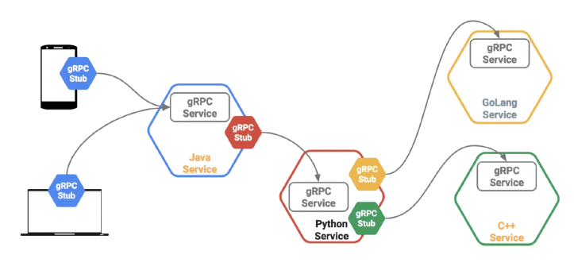
What is gRPC?
gRPC is a modern open source high performance Remote Procedure Call (RPC) framework that can run in any environment.
Simple service definitions.
It automatically generates client and server stubs for your service in a variety of languages.
Unary calls and bi-directional streaming support with HTTP/2-based transport.
Source: gRPC docs

Slide 8
Greeter Service example
service.proto
// The greeter service definition.
service Greeter {
// Sends a greeting
rpc SayHello (HelloRequest) returns (HelloReply) {}
}
// The request message containing the user's name.
message HelloRequest {
string name = 1;
}
// The response message containing the greetings
message HelloReply {
string message = 1;
}
server.go
func (s *server) SayHello(ctx context.Context, in *pb.HelloRequest)
(*pb.HelloReply, error) {
return &pb.HelloReply{
Message: "Hello, " + in.GetName()
}, nil
}
client.go
resp, err = client.SayHello(ctx, &pb.HelloRequest{Name: name})
if err != nil {
log.Fatalf("could not greet: %v", err)
}
log.Printf("Greeting: %s", resp.GetMessage())

Slide 9
Why Protocol Buffers and gRPC?
It’s crucial for high-load services to utilize efficient encoding and
communicate via a fast and reliable channel

Slide 10
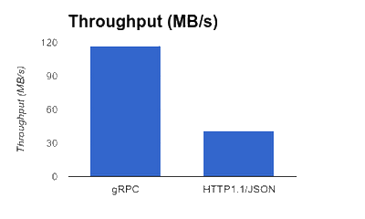
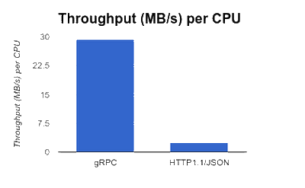
Efficient Data Encoding and Transport Layer
Significant difference in throughput per CPU means you need less resources.
Two major factors behind this difference:
Efficient binary data encoding
gRPC keeps data in binary both in the client memory and on the wire
Binary encoding is more efficient in processing time and space requirements compared to Base64 or JSON
Efficient transport build on top of HTTP/2
Header compression
Multiplexed requests over a single connection
Source: Announcing gRPC Alpha for Google Cloud Pub/Sub

Slide 11
Dealing with Binary Data and gRPC Services
Binary Encoding To deserialize binary data, you need to know the message type and use a compatible version of generated classes in the code.
Making a gRPC call A developed and rich ecosystem offers a variety of tools to make interaction with gRPC services seamless.
grpcurl - Like cURL, but for gRPC. Command-line tool for interacting with gRPC servers.
grpcui - An interactive web UI for gRPC, similar to Postman.
$ grpcurl grpc.server.com:443 greet.Greeter/SayHello \
-d '{"name": "World"}'
{
"message": "Hello, World"
}

Slide 12
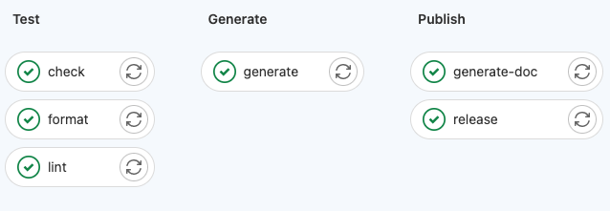
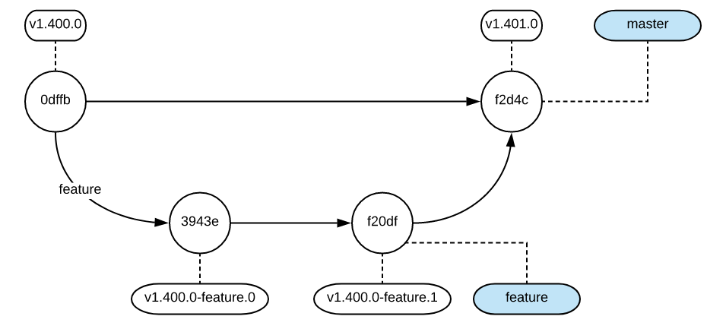
Automation and CI/CD
protobuf-source - git repository with data structure and service definitions.
CI/CD pipeline consists of the following stages:
Test stage.
prototool is used for checking, linting and formatting proto files.
Generate stage produces code files using protoc compiler in multiple languages.
Publish stage.
protoc-gen-doc plugin is used for generating internal documentation.
Release script pushes changes to the corresponding protobuf-gen-* git repositories following semantic versioning.

Slide 13
Monitoring and Observability
Both server and client expose metrics via Prometheus:
Total number of started and completed RPCs, regardless of success or failure.
Total number of RPC stream messages sent and received.
Histogram of response latency of started and completed RPCs.
OpenTelemetry tracing to monitor and troubleshoot calls in complex distributed systems.
Always propagate tracing context.
Use a reasonable sampling rate.
Each service has a dedicated monitoring dashboard.
Well-defined defined SLIs (service level indicators) and SLO (service level objectives) for business critical applications.
gRPC protocol supports interceptors, i.e. middleware that is executed either on the server-side before the request is passed onto the user's application logic, or on the client-side around the user call. It's a perfect place to implement logging or monitoring.

Slide 14
Tips and Tricks
Centralized git repository with data structures and service definitions acts as “source of truth”. It also defines a “contract” between various teams in the company.
Load balancing is tricky. See this guide.
Proxy or client-side load balancing.
Transport (L3/L4) or Application (L7).
Service mesh setup.
Debugging or solving performance issues is quite challenging.
Channelz - a tool that provides comprehensive runtime info about connections at different levels in gRPC.
Additional tooling is required to inspect binary data or making an RPC call.
Invest time in building and owning your own internal tools.
Reverse-proxies make it easy to translate HTTP/JSON requests to gRPC calls.
grpc-gateway - gRPC to JSON proxy generator.
Read more on gRPC support in Envoy.
Check awesome-grpc - curated list of useful resources.

Slide 15
Thanks for your attention!
Questions?

